Slide 1
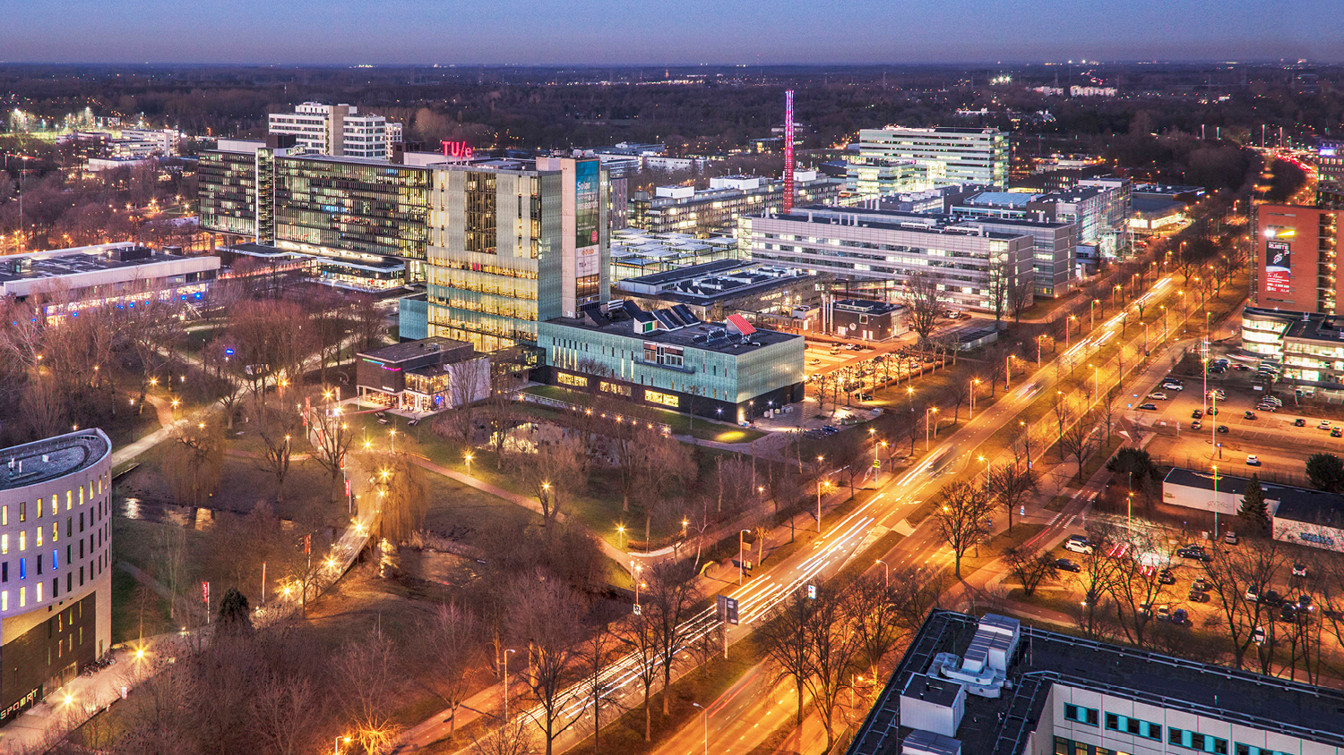
Image-Based Identification and Localisation of Changes in Intraoperative Brain Tumour Resection
Adil Jahouh, 1260340
Mathematics and Computer Science, Visualization
Notes:
Hello everyone, first, thank you all for coming and welcome to my master thesis presentation.
Which is about:

Slide 2
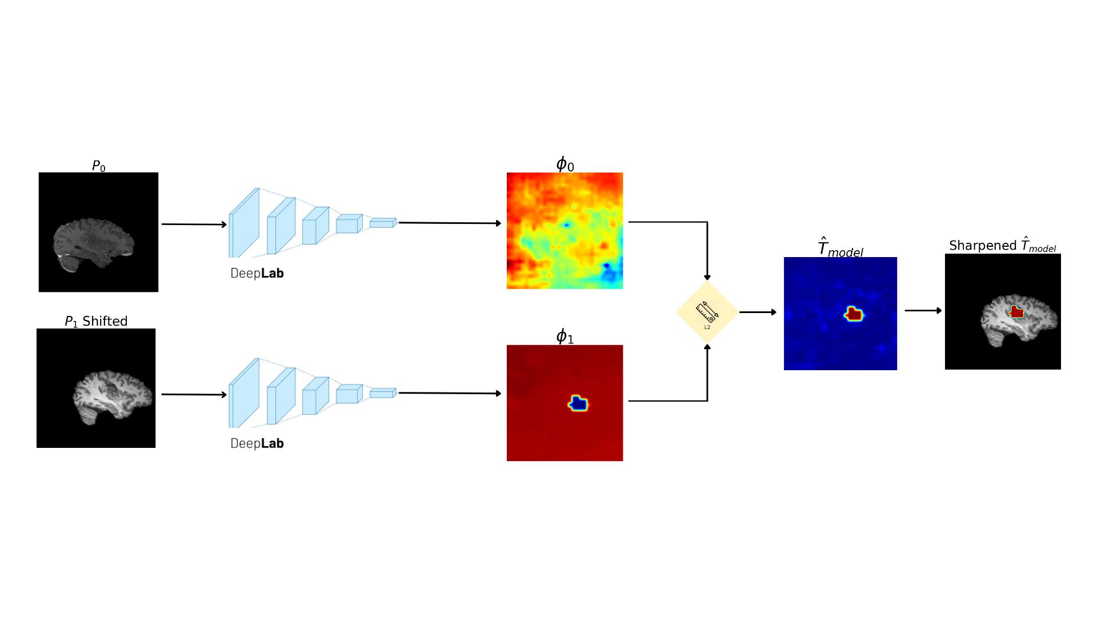
Contents
Introduction
Background
Related work
Research goals
Methodology
Results
Discussion
Conclusion
Notes:
Well, in this presentation I will go over a small introduction to the topic of change detection. Furthermore, I will provide some background information over key concepts in MRI and CNNś .
Then we will go over relevant related work to change detection within and outside of the neurological field.
Then we’ll go over the research goals set within the top
Then ill introduce my proposed registration invariant method with the baseline methods
Then we’ll analyze the results of these methods
And finally we’ll discuss the results, limitations and future work. Ending with a conclusion

Slide 3
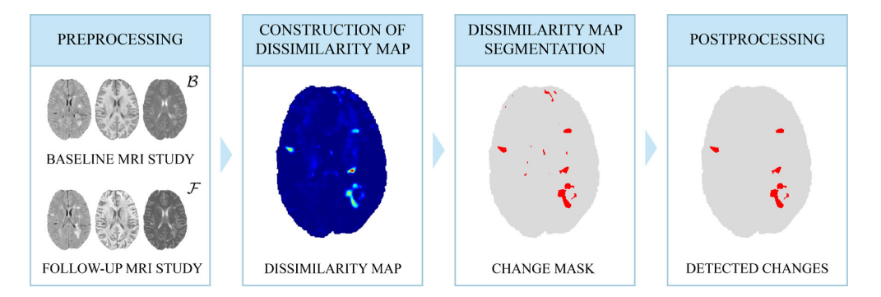
Introduction
“The process of identifying differences in the state of an object or phenomenon by observing it at different times” (Singh, 1989, p. 989)
To include: What (identification) and where (localisation) is the change?
Registration
Artifact correction
Basic method for White Matter Lesions detection (Figure from Lesjak et al., 2016)
Notes:
So change detection is commonly used in fields such as
- The automotive field to enhance self driving
- Monitoring patient progression in the medical field to track thing such as tumor progression
- Agricultural field to track crop management over time
The actual definition of change detection is originilly defined as
- “The process of identifying differences in the state of an object or phenomenon by observing it at different times” (Singh, 1989, p. 989)
This however, has nowadays been extended to where and what has changed as well
Comes with challenge:
- Common approaches rely on registration which is the aligment of this object or phenomen at two different time points in one coordinate spaces. As you can see in the image below this basic method for white matter lesions requires registriation. As two images of the brain taken at two different timpoints (which is referred to as baseline and followup) have to be subtracted to create a DM, and then a change map can be constructed to eventually be filtered out again to generate the actual changes.
This, method, however requires a lot of preprocessing such as registration,
and brain artifact correction such as acquisition differences, and such.

Slide 4
Introduction
Deep Convolutional Neural Networks
Siamese Network of Segmentation models
“Registration-invariant approach to CD, which is able to identify, localise and visualise changes intraoperative brain tumour resection”
Notes:
However, there are methods in computer vision that inherently deal with things such translations, and noise. CNN’s are capable of being invariant to noise and misalignment by applying certain methods. Furthermore they allow for the extraction of feature maps which can be repurposed for the segmentation of for example tumor tissue.
Therefore we propose a regirstion invariant method… This means that we attempt identify if changes have happened between a preopartive scan and intraoperative scan (which is during the operation) and we localize these changes pixel-wise and visualize structural changes by using specific imaging techniques

Slide 5
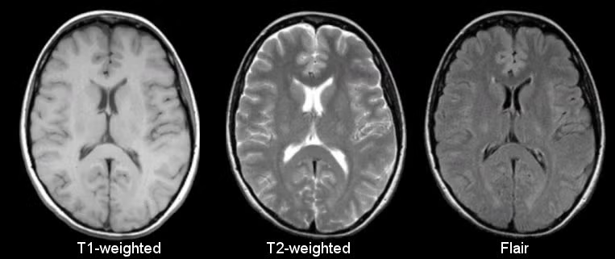
Background
Preoperative (B) and intraoperative (F)
Structural MRI
Imaging techniques
Fat and water concentration
Notes:
For change detection we’ll need a baseline and followupt stat which in the neurological field is is the preopeartive and intraopetive image.
The intraoperative state that shows the structure of the brain after the tumor has been resected and a preoperative state before the operation to compare with.
To acquire tehse anatomical images we’ll be using Magnetic resonance imaging. Mri typical uses magnetic fields and the magnetic properties of hydrogen and fat atoms to map out the physical sstate of the brain, based on the reaction of these atoms on radiofrequencies.
Within structural Mri there are different imaging methods, such as T1-weighted t2-weighted and falir which exhibit differences in settings and highlight different tissue types. T2 for example is more vulnerable to water content whilst flair applies this as well but nullifies cerebral spinal fluid completely. The T1 on the otherhand uses fat concentration to highglight white and gray matter.

Slide 6
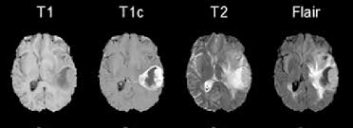
Background
Tumor chacteristics
Notes:
As for the appearnce of tumors within MRI, main tumors which we’ll be discussing such as lgiomas (inside) and meningiomas (outisde brian tissue), can be visualized using these mthods. As gliomas have high water content and appear within the brain and meningiomas appear outside of brain tissue so near the skull and are quite disruptive so can be captured with contrast enhancmenet.

Slide 7
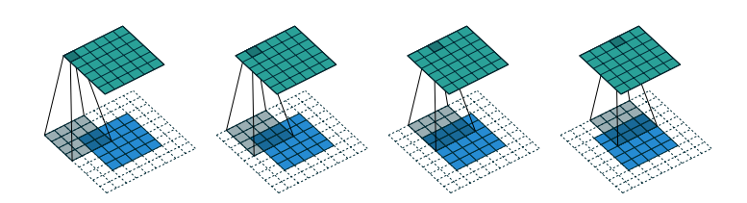
Background
Convolutional Neural Networks
Kernels
Down-sample
Padding
Notes:
In this study we’ll be using segmentation models as our main backbone for change detection. These segmentation models are based on CNN’s.
CNNś use kernels, which are small matrixes that are learnt through the models lifecycle and move over the the input data, extracting features by performing element-wise multiplicant and summations
This however can cause the original input image to downsample, losing tis spatial detail. This is why you often apply operations such as padding to maintain spatial detail.
This and operations such as pooling layers, which are FIXED operations applied to the input data, can downsample the initial input image, allowing for ease in computation and summation of most important featurs
.

Slide 8
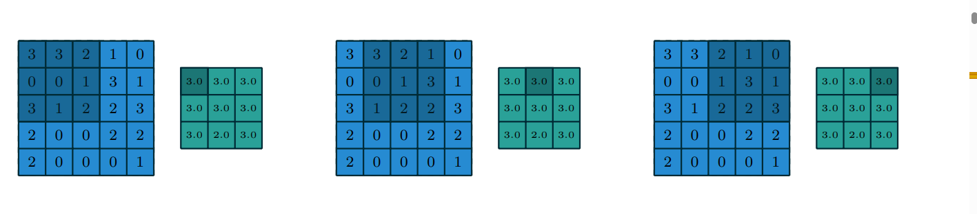
Background
Pooling
Generalisation
Computation
Receptive field (context)
Why is this important?
Loss of spatial detail
Notes:
However, CNNs prefer this loss of spatial detail for the tradeoff of retainment of the most important details. Max-pooling is often applied to only retain the highest intensity value within the model to work with the most important details to not overfit and easy computation. This results in better generalisaiton, lower computational costs and bigger receptive field because we’re working with aggregated data in a smaller field.
Why is this important?
Well, segmentation models want to extract these feature maps, to see hwere the model is exactlyfocussing on. IF we don´t pool we cant capture long-range features as we’re tied to the range of our kernel. But if we do pool we lose Losing spatial detail can be detrimental to segmentation models and thus a common approach is to use

Slide 9
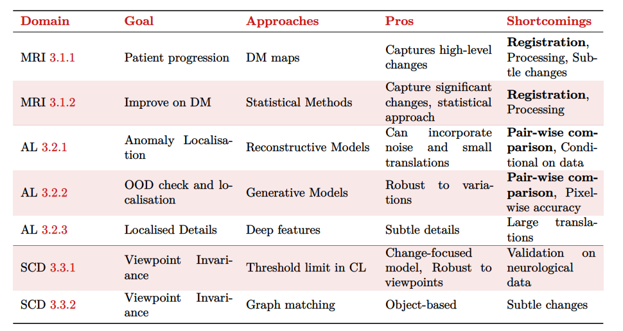
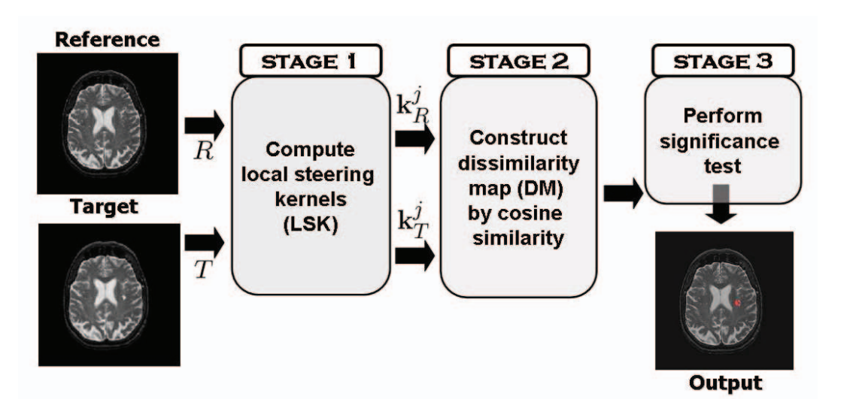
Related work
Notes:
We will also go over some related work. More specifically approaches and methos within the MRI field such as the difference map techniques. Anomaly localization techniques within other fields and Scene change detection.

Slide 10
Related work
Notes:
We will also go over some related work. More specifically approaches and methos within the MRI field such as the difference map techniques. Anomaly localization techniques within other fields and Scene change detection.

Slide 11
Related work
Notes:
We will also go over some related work. More specifically approaches and methos within the MRI field such as the difference map techniques. Anomaly localization techniques within other fields and Scene change detection.

Slide 12
Research Goals

Slide 13
Methodology

Slide 14
Results

Slide 15
Discussion

Slide 16
Conclusion

Slide 17
Example chart - Column

Slide 18
Example chart - Column

Slide 19
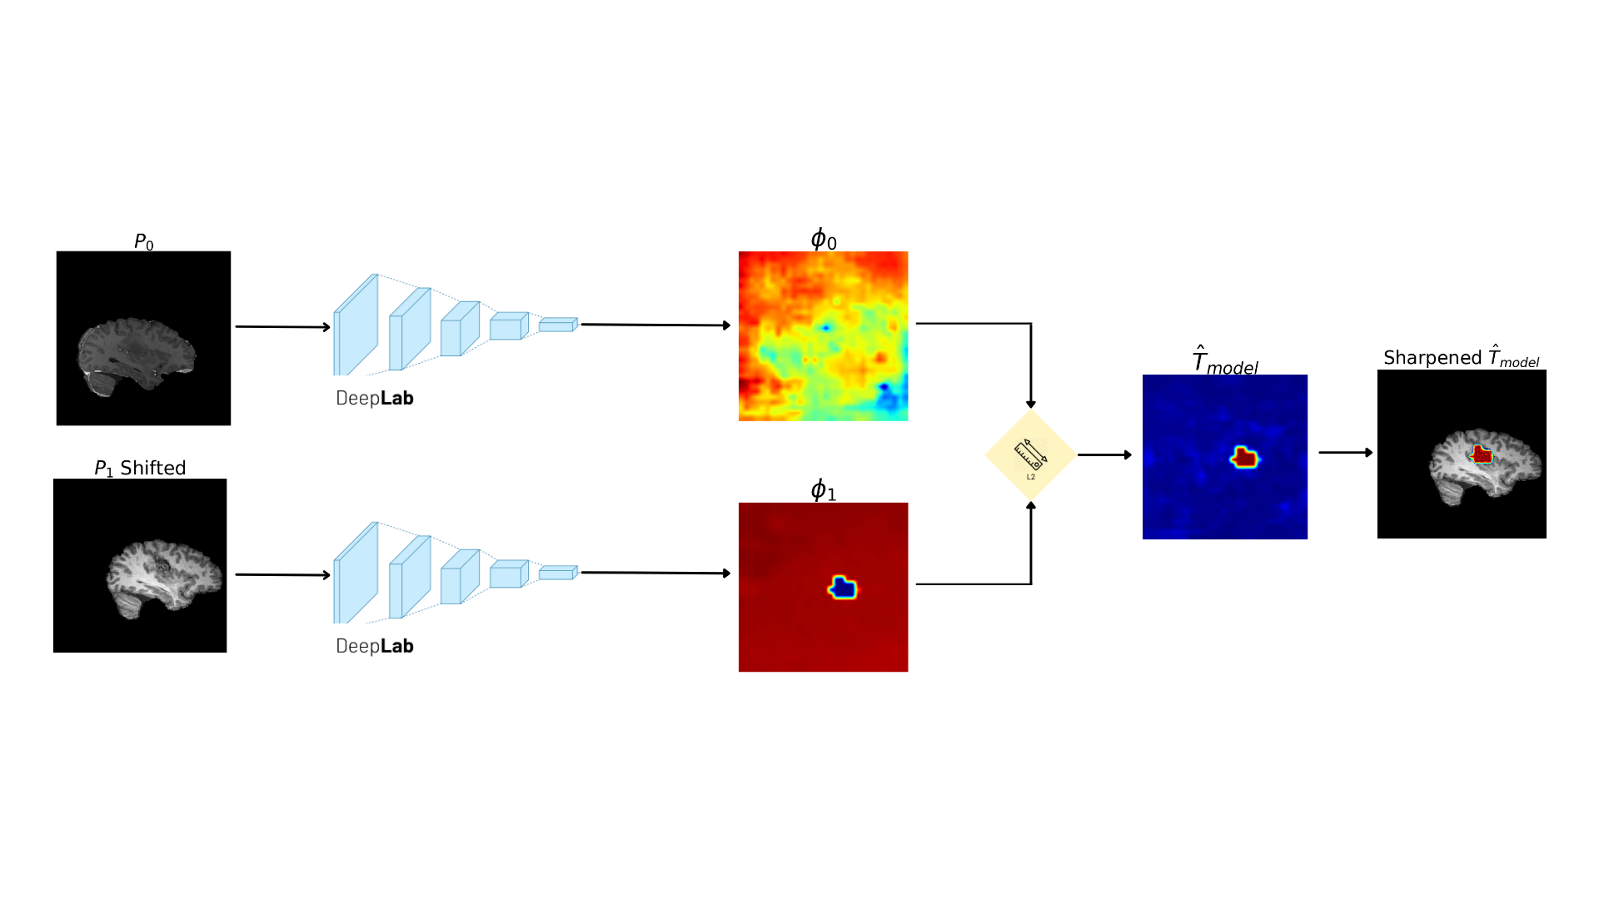
Example chart - Column

Slide 20
Example chart - Column

